Slide 1

MAEER’s Maharashtra Institute of Technology, Pune
Department of Computer Engineering
Personality Prediction Using Social Media Post

Slide 2
Made Under Guidance of –
Prof (Mrs.) Mamta Bhamare
Student Names and Exam Seat Numbers :-
Jay Naik (71700258G) (403046)
Ajinkya Pingale (71700465B) (403061)
Manoj Nandha (71700401F) (403047)
Akash Misal (71700377K) (403043)

Slide 3
Motivation
To Understand the personality model.
For Recruiting the candidate for the proper job description.
To get the relevant information of user for recommendation and Online Marketing
To detect the personality description for consulting services and E-commerce services

Slide 4

1.
Literature Survey
Next few Slide has the Literature Survey we did for our Project

Slide 5
Sr No | Paper Title , Author , Year Of Publication | Concepts Described in paper | Gaps in the Paper
1. | Persona Identification Traits Based On Approach By Srilaxmi Bhardwaj, Srinidhi Sridhar , Rahul Chowdhary and Ram Srinath | MBTI , Count Vectorization, LIWC, Lemmatization, TF-IDF | Lack Of Implementation Of Deep Learning Methods , Only Baseline Methods
2. | Predicting Students Personality Based On a data driven Model By Mohamed Halawa, Eleman Sehbab and Essam Hamed | JRIP , KNN , MBTI , LMS OneR , Random Forest , J48 | Designed Specifically For Student Behavior ignoring some of 16 MBTI Traits

Slide 6
Sr No | Paper Title , Author , Year Of Publication | Concepts Described in paper | Gaps in the Paper
3. | Personality Prediction Based on User Behavior By Michael Tadesse , Bo Xu , Liang Yang at IEEE Conference Vol 29 | Big Five Model , SNA , Splice , LIWC , XGBoost , OpenNLP , Gradient Boosting | Based On a Small and Basic Dataset Hence Accuracy Takes Hit and Can’t be trusted
4. | Personality Recognition on Social Media with LDL By DI Xue, Zheng Hong and Shize Guo in IEEE | Pearson Correlation , Label Distribution , PT-SVM Classifier , Big Five Model | Uses local Chinese Dataset and predicts using TextMind which cant be used on other languages easily

Slide 7
2. Problem Statement
This Section Describes What are the Problem Statement and its Justification

Slide 8
Problem Statement
One of the Major Platform today to express your emotions expression , feelings , views about something or about any product is Social Media .
People can put forward their opinion on social media , since active social media user base around world is more than that of billions , it can be used to judge what people think about an issue or product .
People put forth what they feel , therefore their individual post can be judged as a reflection of their personality
Therefor the problem statement is to predict personality of a person using his social media posts .

Slide 9
Justification
Traditionally all the personality detection was done by questionnaire.
When Researchers opted for social media analysis , first they went for traditional baseline methods
Accuracy was limited in this approach
So we used Deep Learning Based Methods to learn from the data
Through Deep Learning methods we could now extract more out of a sentence which wasn’t possible earlier.

Slide 10
3. Project Concepts and Modules
Bring the attention of your audience over a key concept using icons or illustrations

Slide 11
Dataset Description
MBTI Dataset
We used a kaggle Dataset for training MBTI model this Dataset is a labelled dataset and has more than 8600+ Rows and It has two columns One Showing a specific Trait and other showing Tweets of that Type . This Dataset isnt a Clean one and there is lot of irrelevant things that we would have to remove in preprocessing Step. Each Tweet in a row are separated by 3 pipe pattern and this tweets also has some additional characters like @ "" etc. It has more than 433000 Tweets

Slide 12
Big Five Dataset
We used a MyPersonality Dataset for training Big Five model this Dataset is a labelled dataset and has more than 9918 Rows and It has 21 columns Each One Showing a specific Tweet and Out of Five points on each of five traits . This Dataset isn't a Clean one and there is lot of irrelevant things that we would have to remove in preprocessing Step. It has more than 9918 Tweets as it contains only one tweet per person or AuthorId

Slide 13
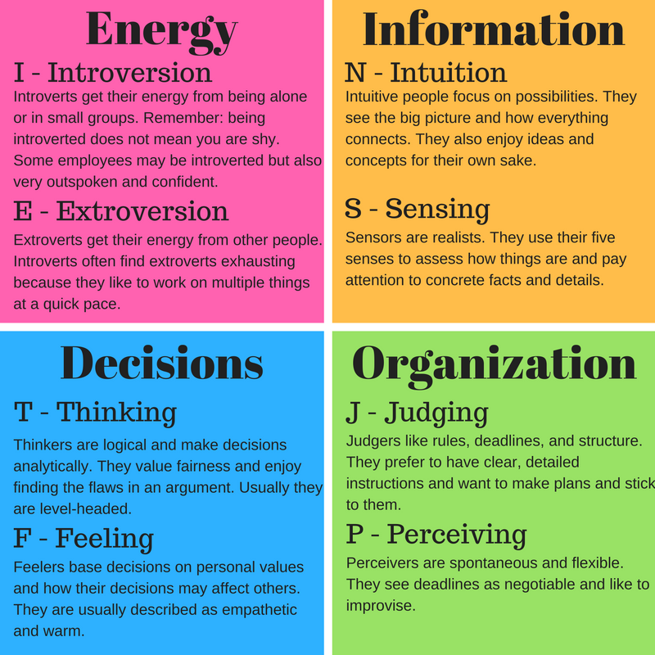
MBTI Module

Slide 14
Big Five Model
The "big five" are broad categories of personality traits. While there is a significant body of literature supporting this five-factor model of personality, researchers don't always agree on the exact labels for each dimension.
Big Five Trait Evaluation Model is Known By Five Significant Traits -
Openness (O)
Conscientiousness (C)
Extraversion (E)
Agreeableness (A)
Neuroticism (N)

Slide 15
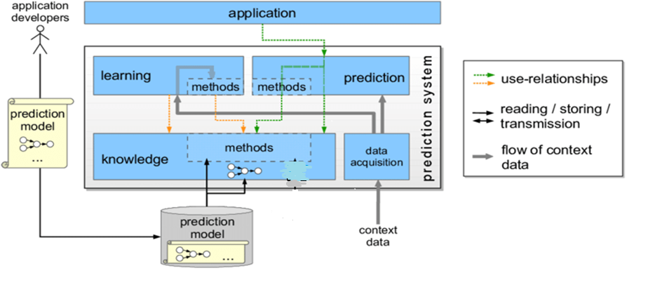
System Architecture

Slide 16
Preprocessing
Remove Quotations, Commas, Http Links, @ mentions
Lemmatizations
Stop Words
MBTI Keywords (Not in the case of Big 5 model)

Slide 17
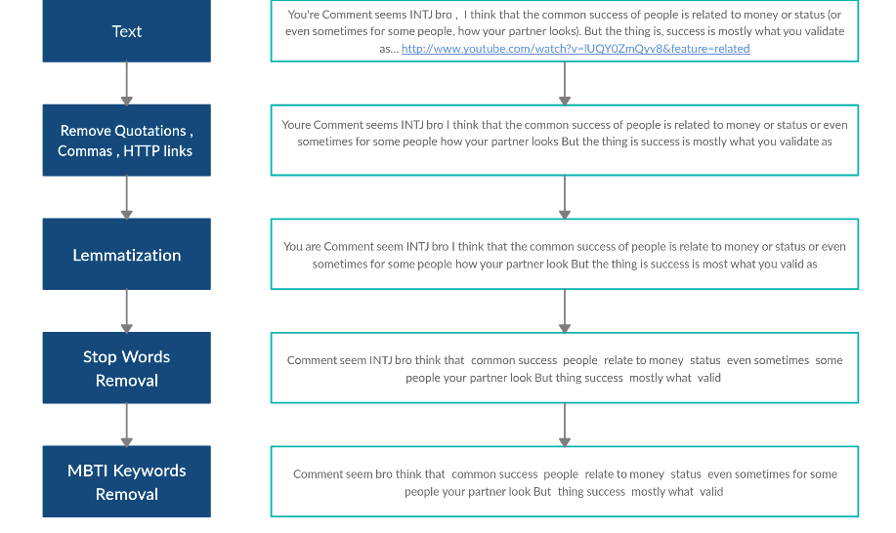

Slide 18
Embedding Matrix
Using Glove pre-trained embedding layer
50d (Used in MBTI)
100d
200d
300d (Used in Big 5)

Slide 19
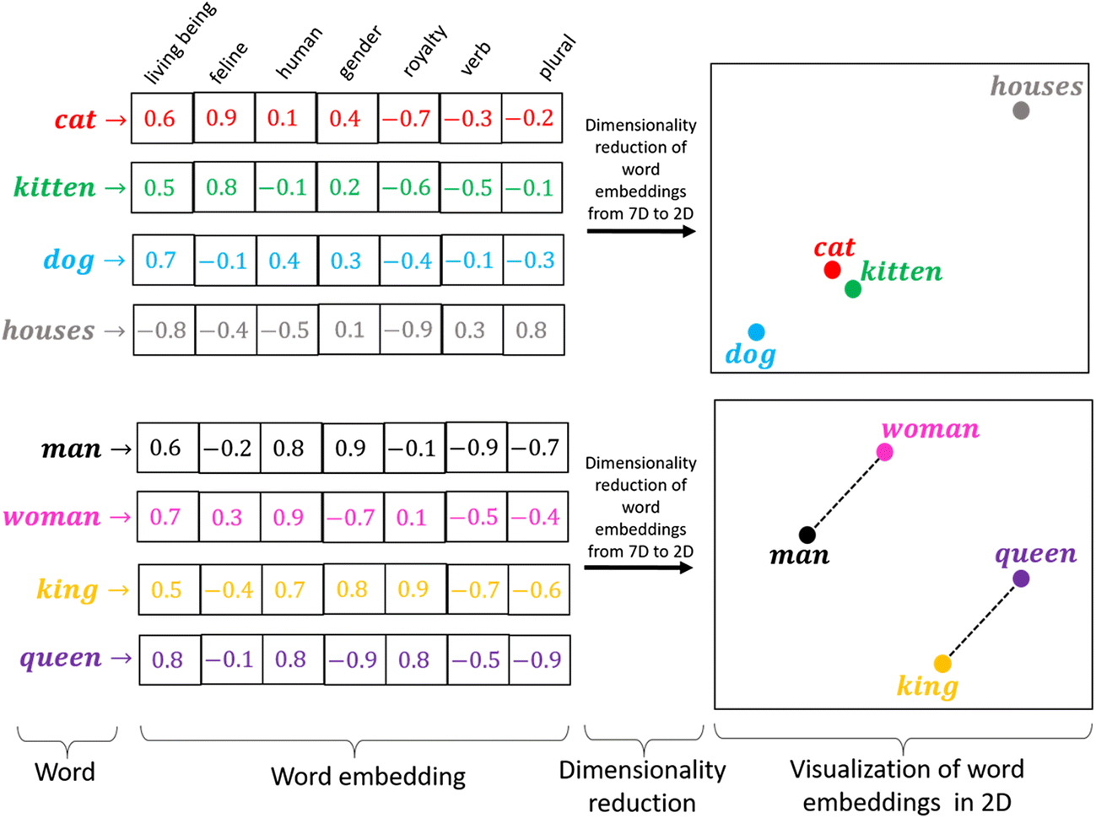

Slide 20
Modelling
Traditional Modelling
Baseline Methods
Naive Bayers
XGBoost
Support Vector Machine ( SVM)
Random Forest, Decision Tree

Slide 21
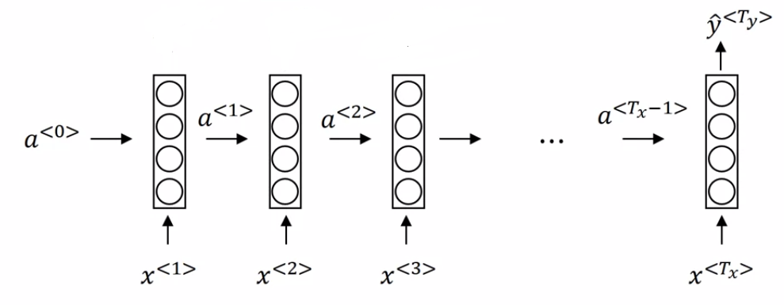
Deep Learning Approach
Had
great
day
today
0

Slide 22
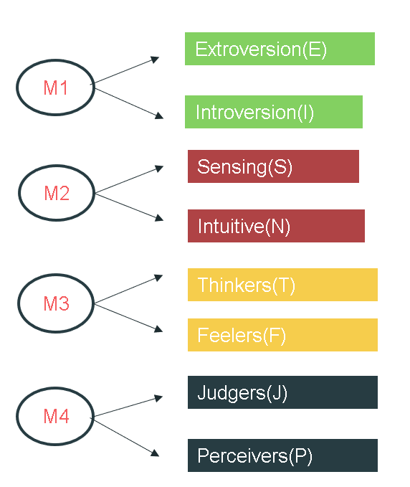
Trait Distribution

Slide 23
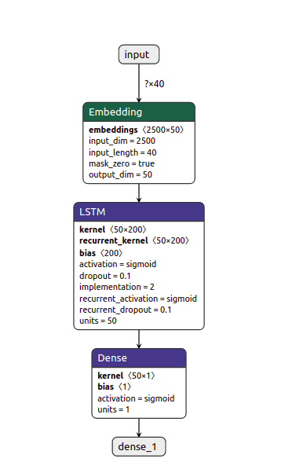
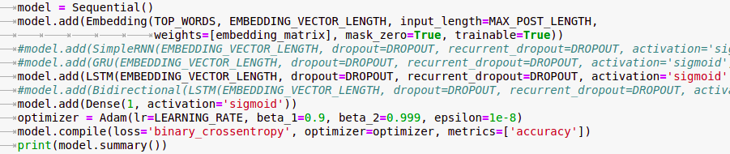
MBTI Architecture

Slide 24
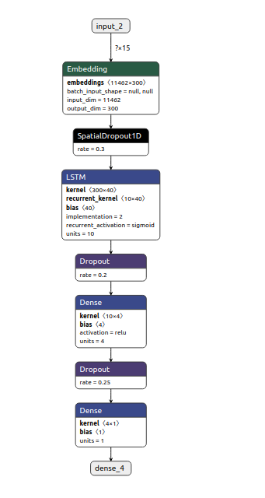
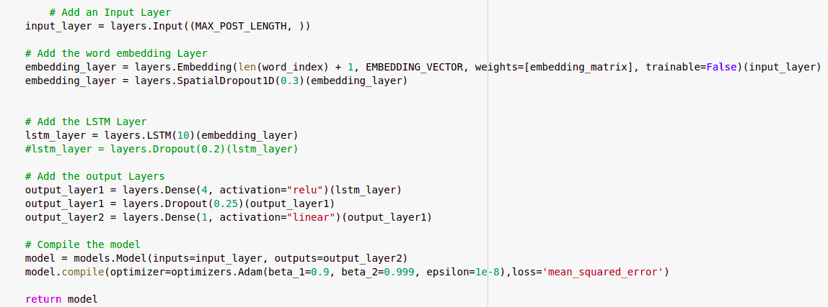
Big Five Architecture

Slide 25
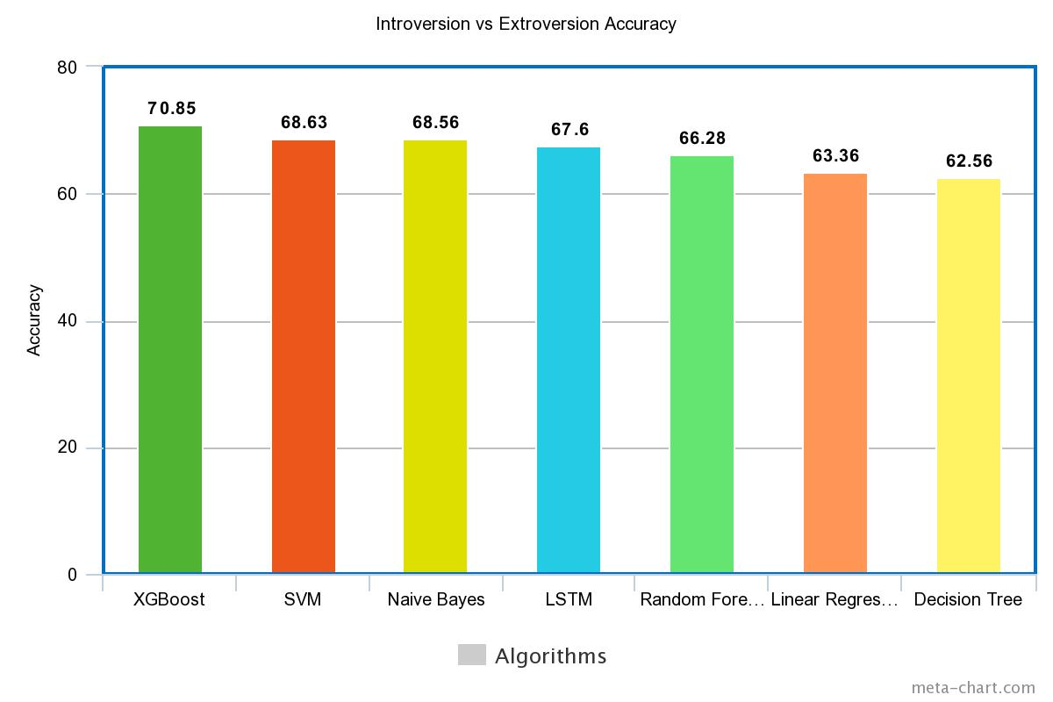
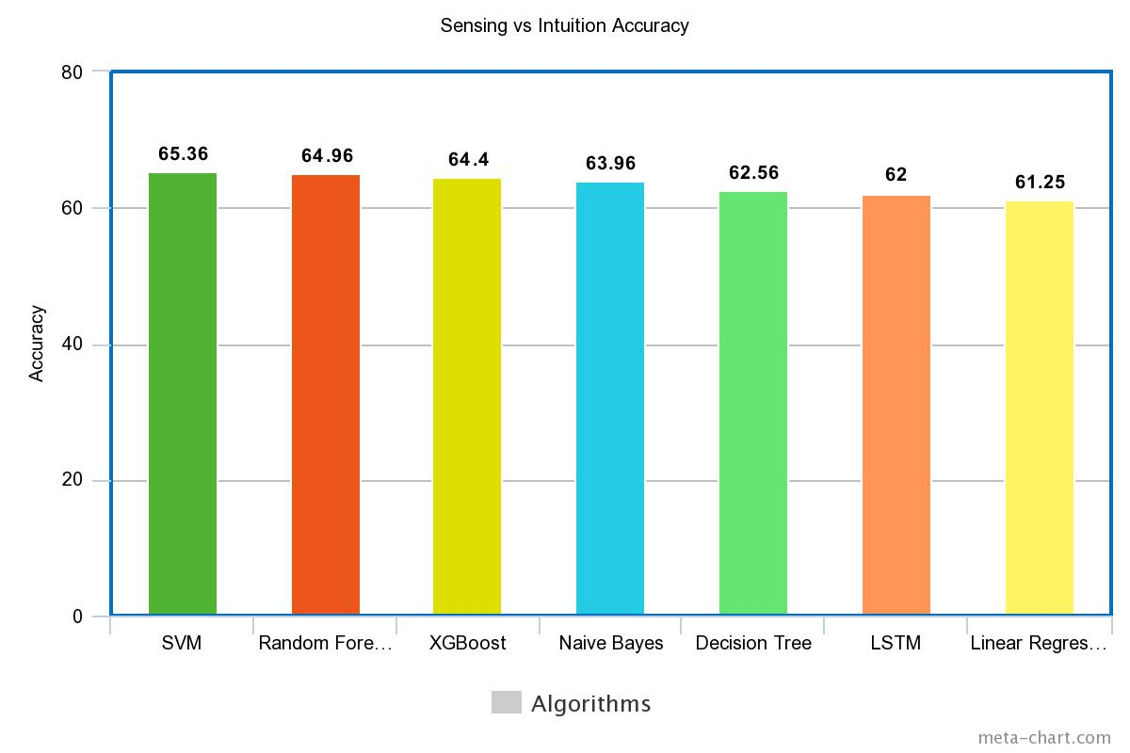
MBTI Training Results

Slide 26
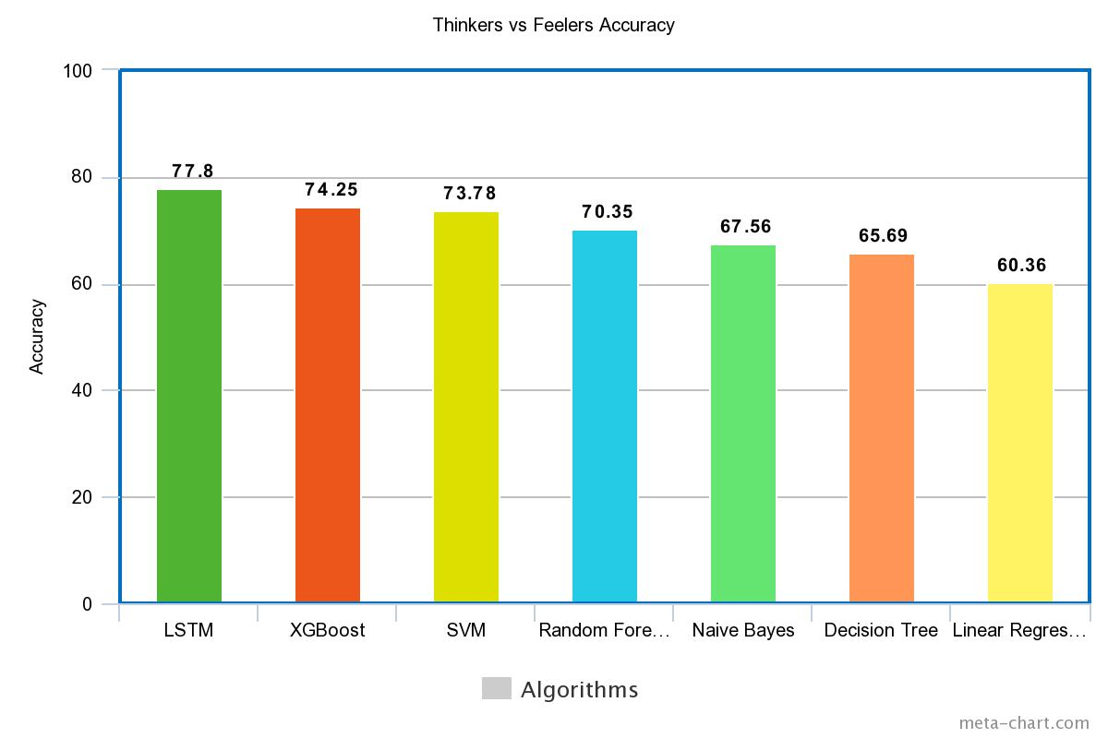
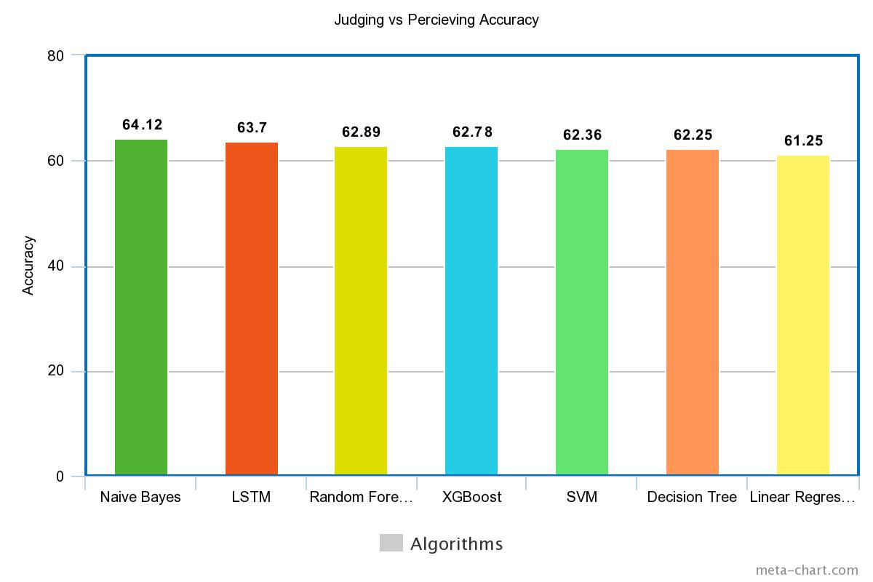
MBTI Training Results

Slide 27
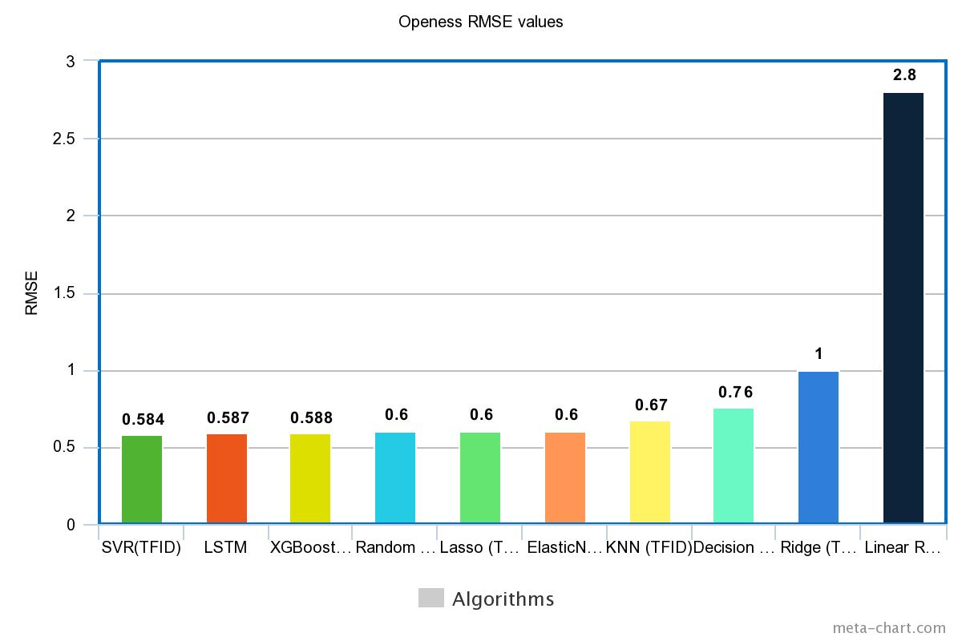
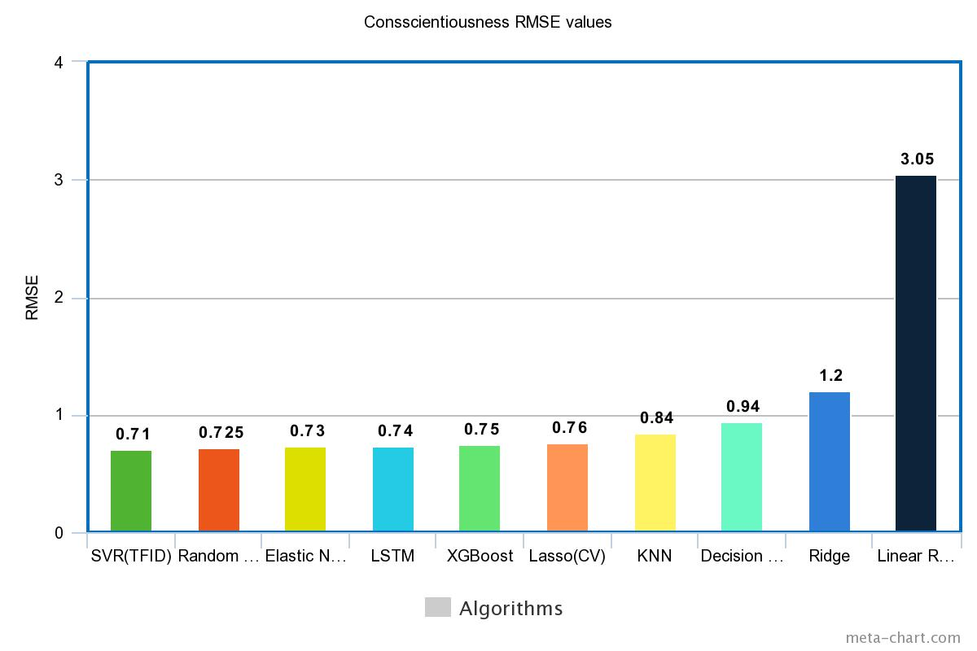
Big Five Training Results

Slide 28
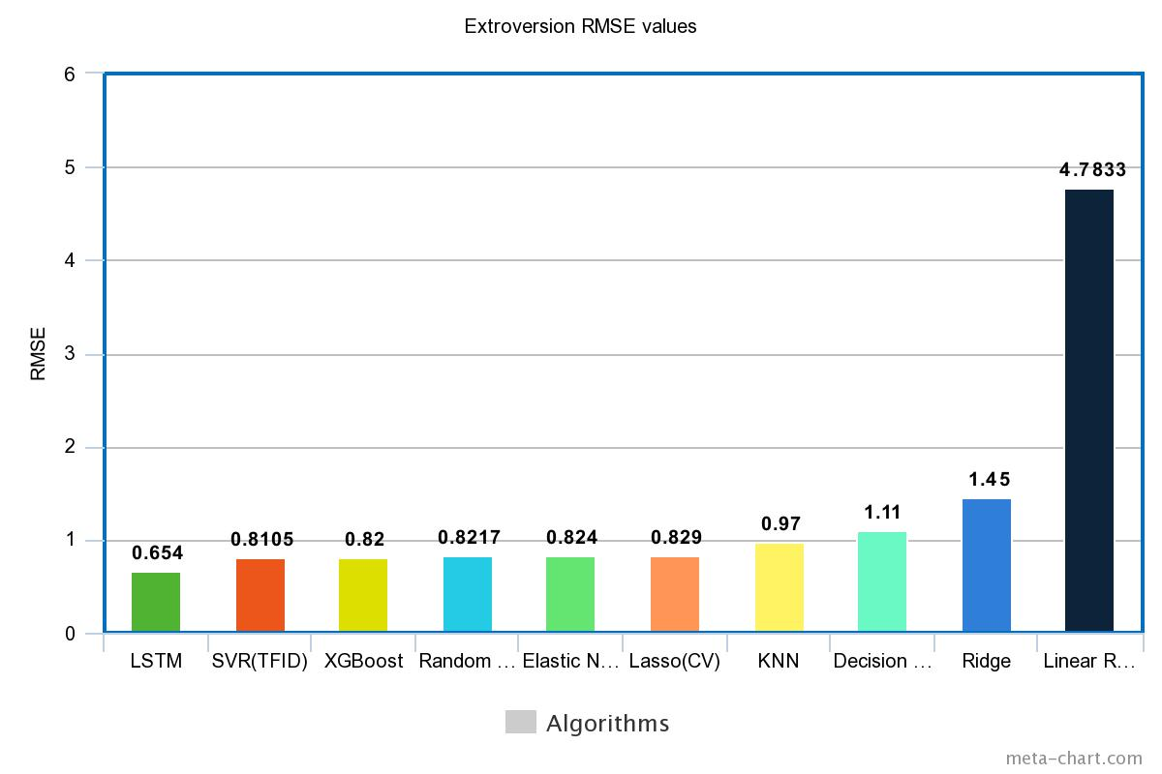
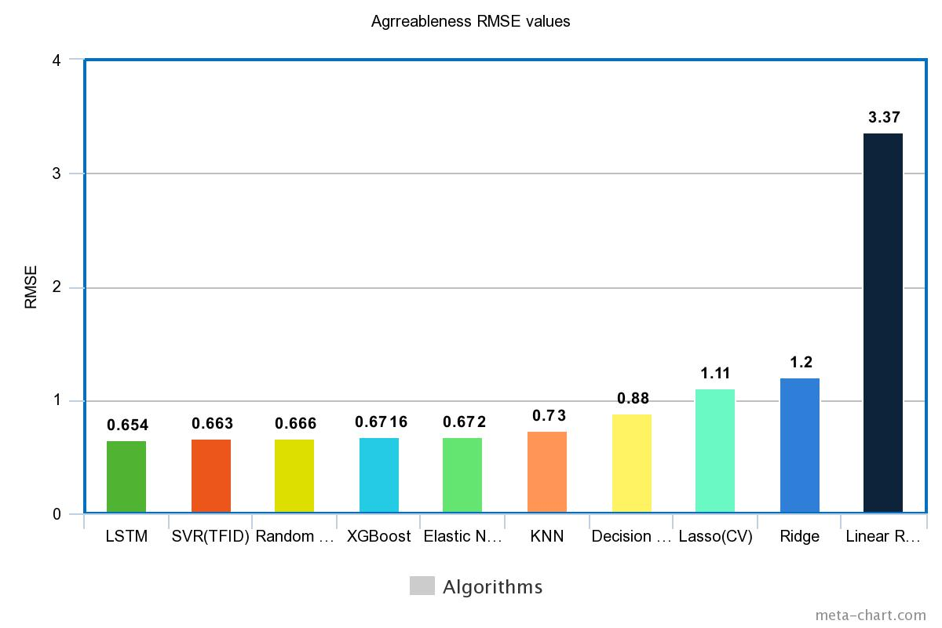
Big Five Training Results

Slide 29

Big Five Training Results

Slide 30
Test Cases
Donald Trump - The President Of United State Of America tweets using the official twitter id of 'potus'. Using Our Model We Calculated the personality to be ISTP with I calculated at 54% whereas Studies suggest it to be ESTP with I calculated at 48% which is quite close.
Leonardo Di Caprio - The Famous Oscar Winning Actor Leonardo Di Caprio who uses twitter if of 'LeoDiCaprio’. Our Model Predicted the personality to be ESTP where as studies suggest that result to be ESFP

Slide 31
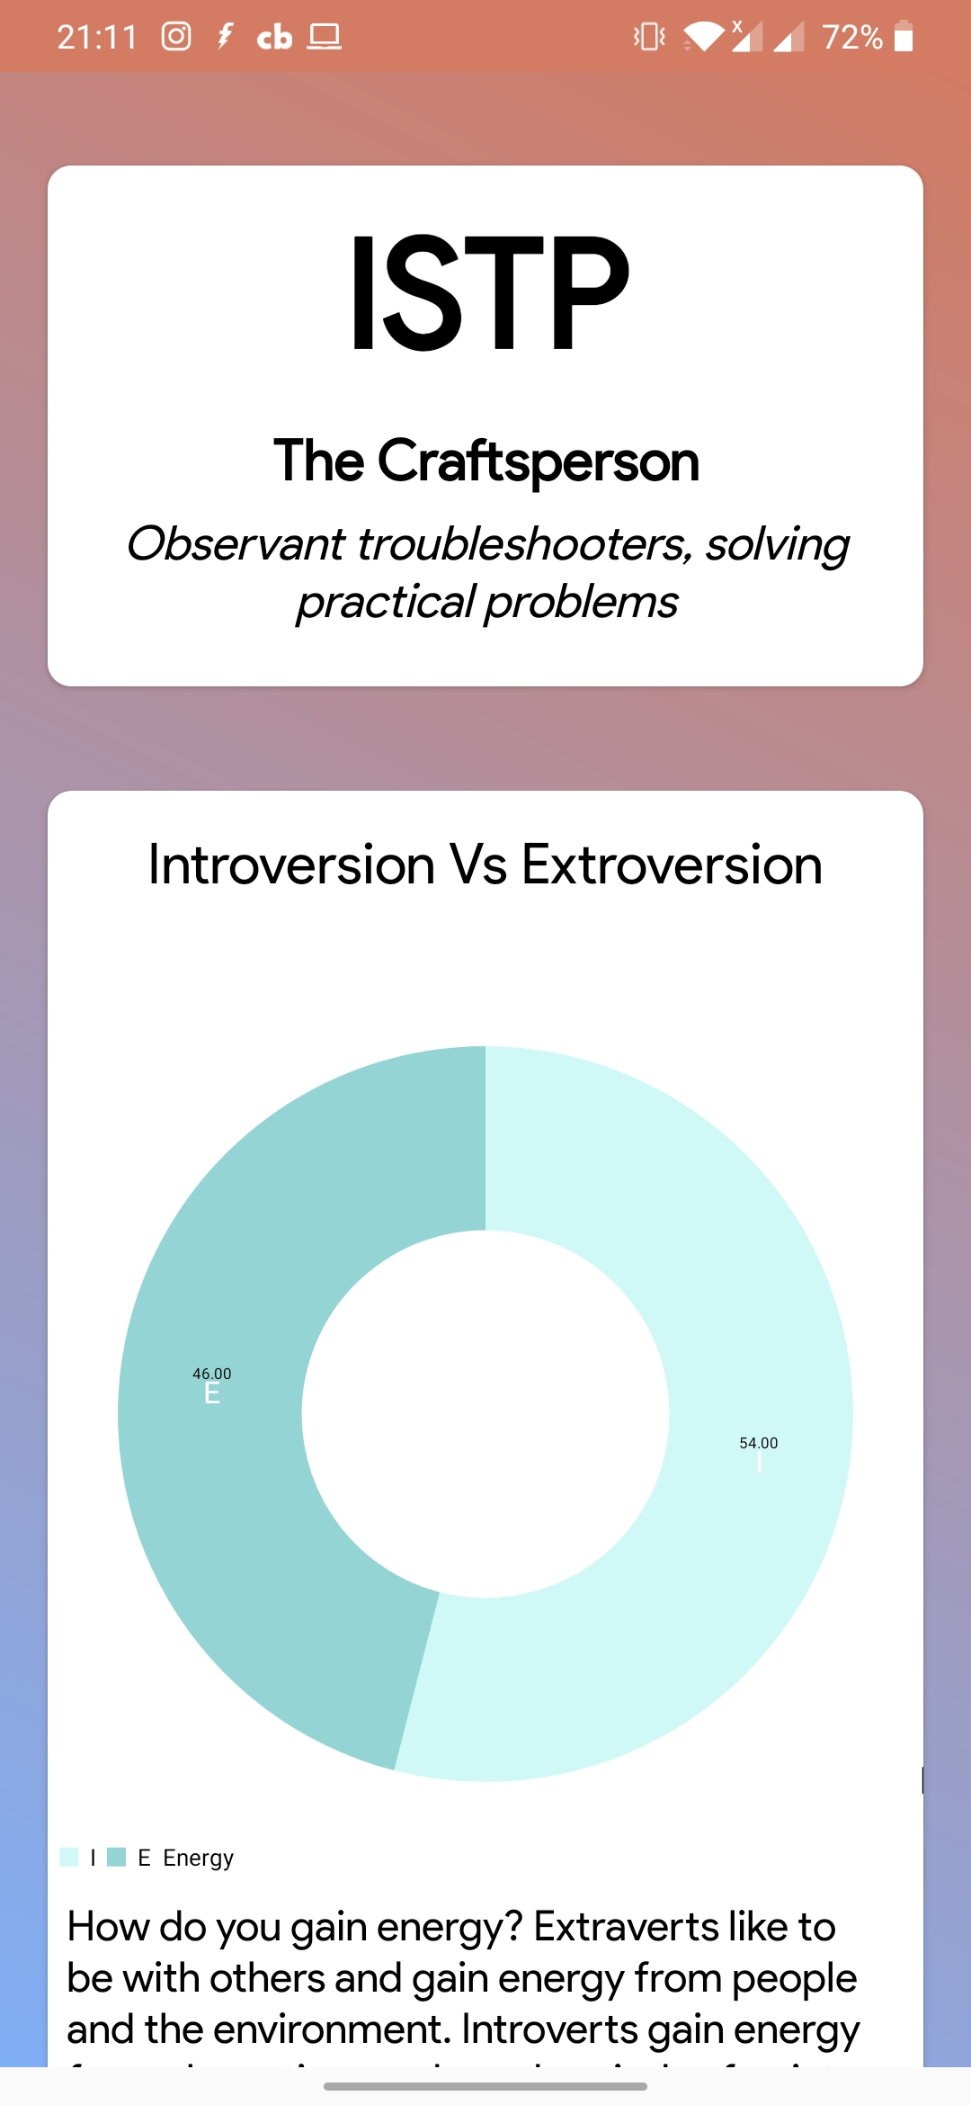
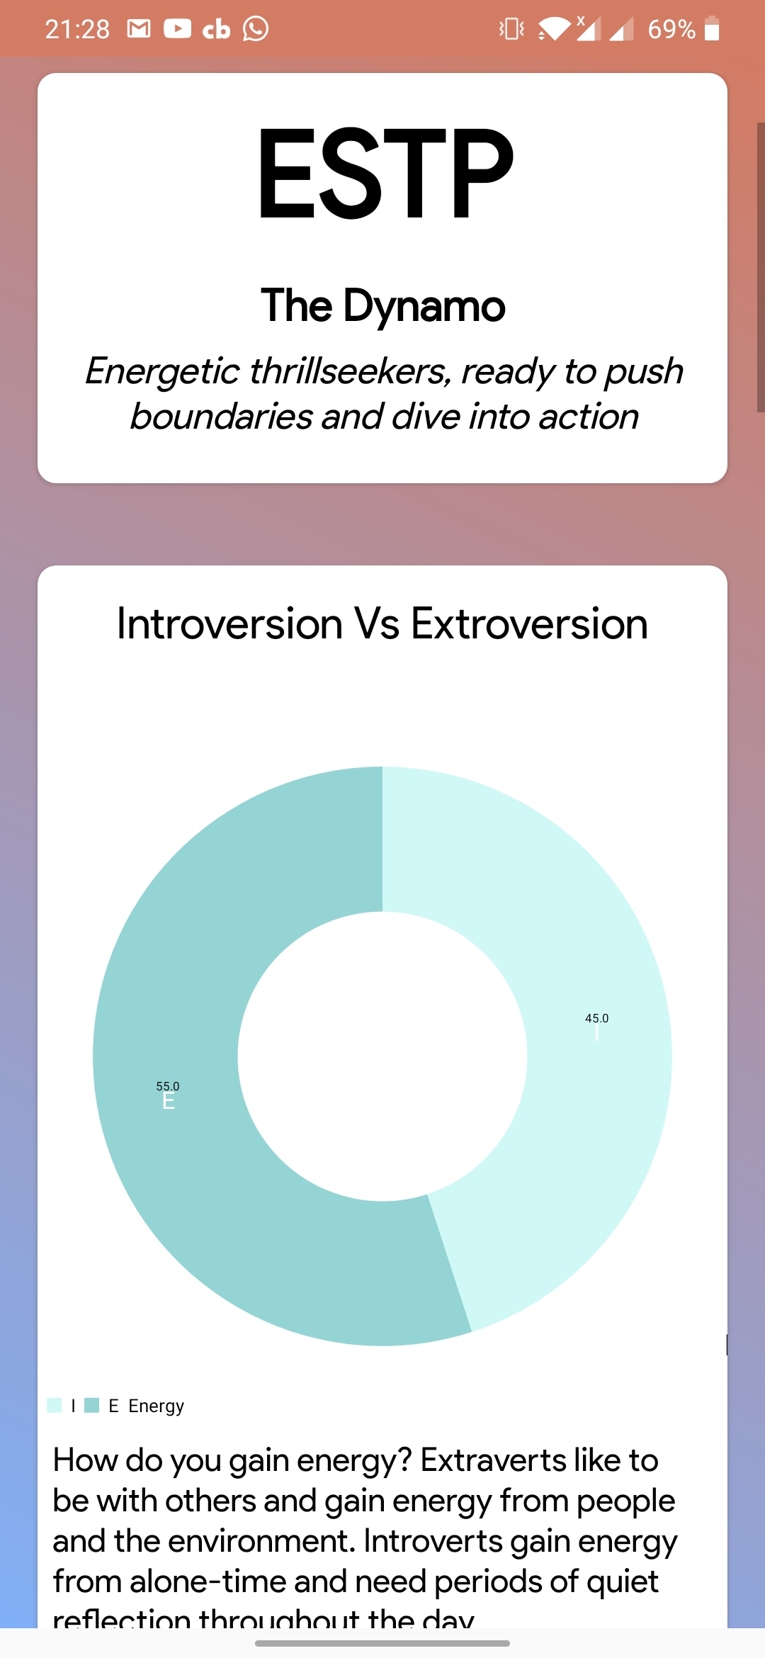
Donald Trump Prediction Leonardo Caprio Prediction

Slide 32

Android APP
We Made An Android App to Implement this Model
Our Aim was to make this method available to general public so that they can use it and we could also know how our model performs
We Implemented Chaquopy Python Library SDK to Implement Python on Android
We are showing detailed graphs and pie-charts to show trait points

Slide 33
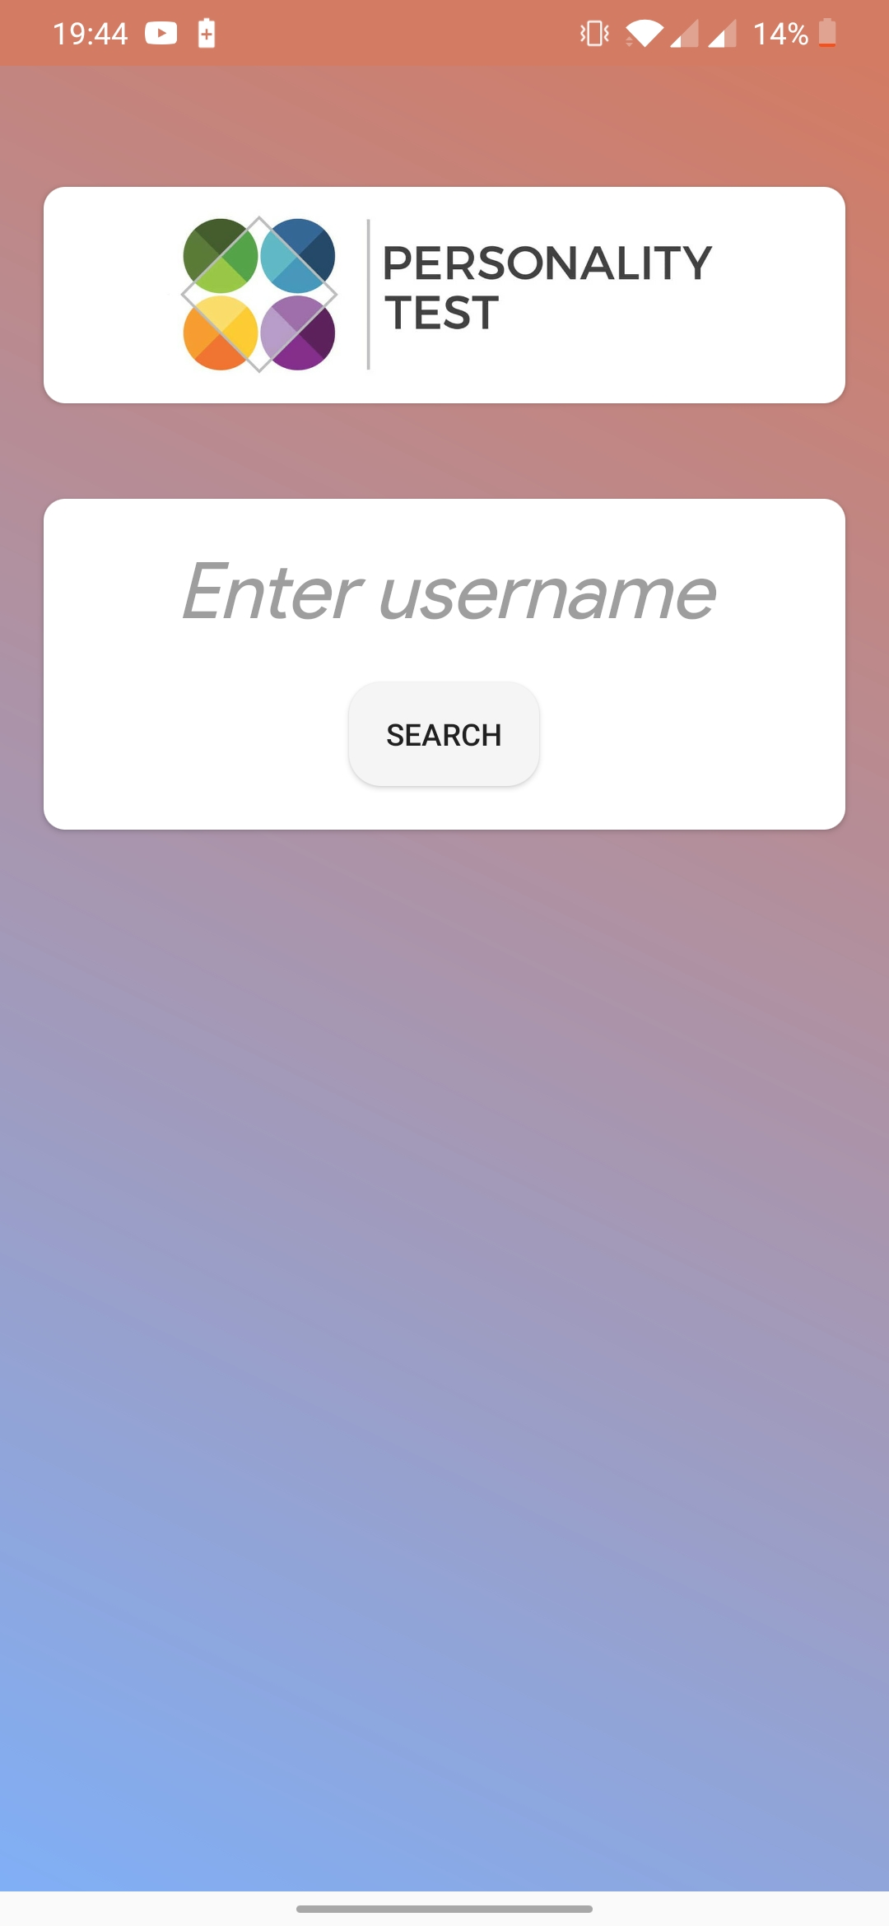
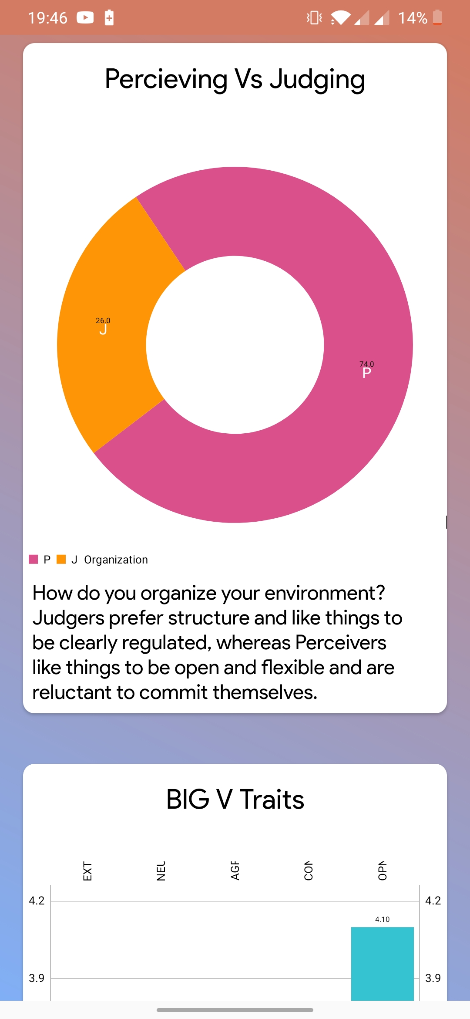
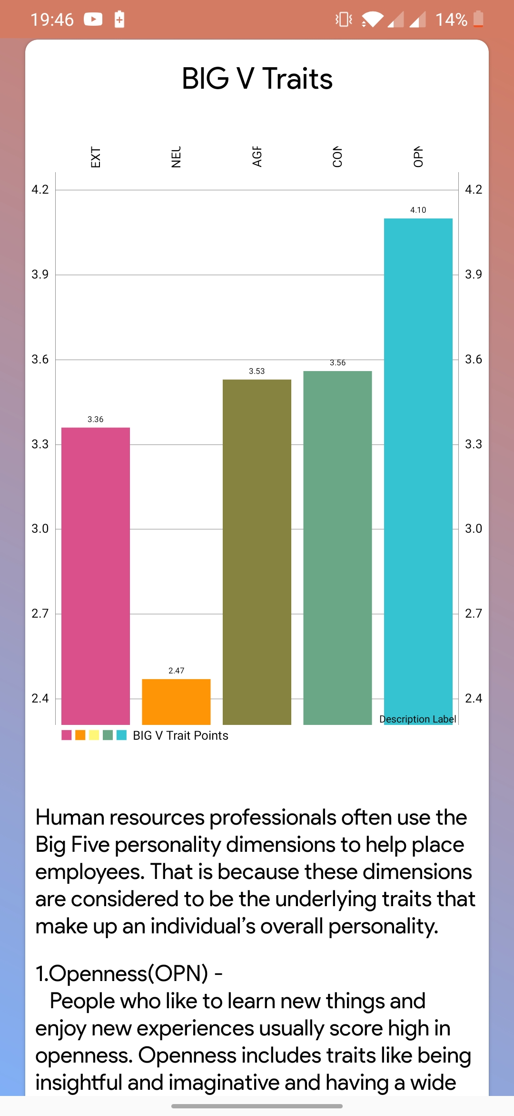
App Screenshots

Slide 34
4. UML Diagrams
This Section Has different UML Diagram that best describes the system

Slide 35
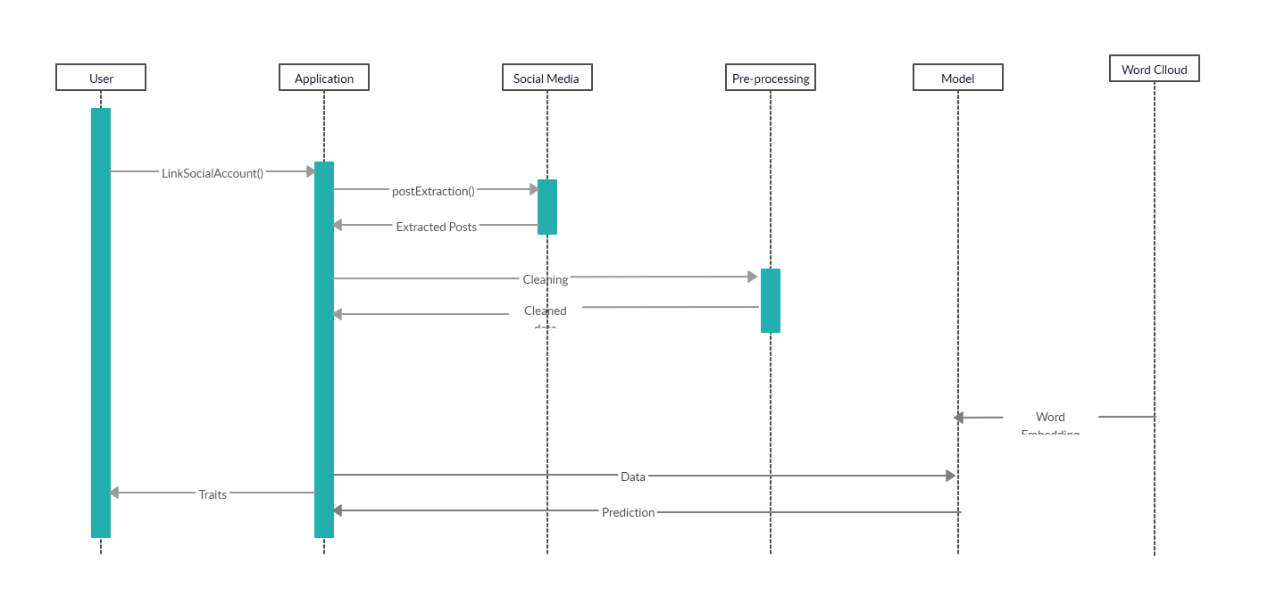
Sequence Diagram

Slide 36
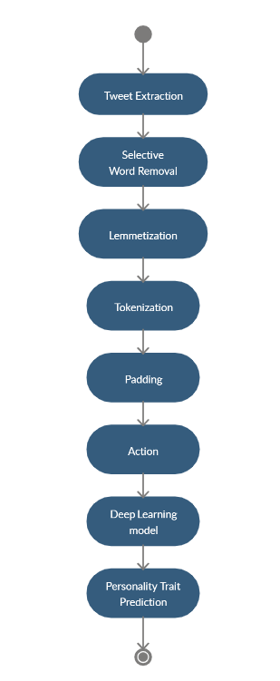
Activity Diagram

Slide 37
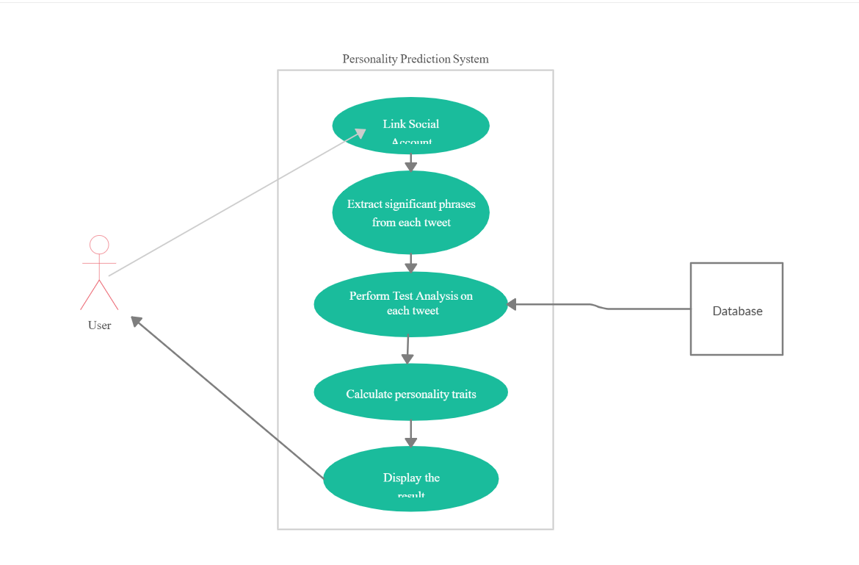
Use Case Diagram

Slide 38
Applications
Recruitment
Counselling
Online Marketing
Corporate
Psychological Profiling
E-Commerce/E-Learning
Recommendation System

Slide 39
Conclusion
Personality identification using social network analysis is a relatively new domain within machine learning research.
Since its introduction, however, it has drawn increasing attention by the research community with applications in wide variety of domains.
Traditionally the only way personalities were identified was through questionnaire based personality tests that the subjects used to undergo.
The surveyed techniques for automatic identification from online social networking
profiles have yielded promising outcomes. Yet, many opportunities exist.

Slide 40
References
Understanding Personality through Social Media - Yilun Wang
Personality Predictions Based on User Behaviour on the Facebook Social Media Platform - MICHAEL M. TADESSE , HONGFEI LIN , Bo Xu and Liang Yang
Personality Recognition on Social Media With Label Distribution Learning - DI Xue , Zheng Hong , Shize Guo , Liang Gao , Lifa Wu
Analyzing and Preventing Bias in Text-based Personal Trait Prediction Algorithm - Shimei Pan and Isil Doga Yakut Killie
Social Media Text - A Source for Personality Prediction - PS Dandanvaar , SR Mangalwade and PM Kulkarni

Slide 41
THANK YOU!!!
Any questions?

